Slide 1
Operating Systems
Dr. Deepak Dembla

Slide 2
File System

Slide 3
Objectives
The logical concept of file and file system
Internal Structure of a file
Record blocking
File naming conventions
Various Types of file
Various Attributes of a file
Different Operations performed on a file
How the files are implemented
Methods how a file can be accessed
The concept of directory
The logical structuring of directories
How the files can be shared
File protection issue
The concept of File system mounting

Slide 4
Files and file system
a file as a logical concept is not stored on a permanent media. Therefore, after saving our work in the form a file needs to be mapped on the storage device.
a file system as a part of operating system exists that provides a facility to create, store and retrieve the information in the form of files. The operating system abstracts the actual storage of the program and data from the user and provides him a logical and convenient file concept.
A file as a logical concept is not stored on a permanent media. Therefore, after saving our work in the form a file needs to be mapped on the storage device.
A file system as a part of operating system exists that provides a facility to create, store and retrieve the information in the form of files. The operating system abstracts the actual storage of the program and data from the user and provides him a logical and convenient file concept.

Slide 5
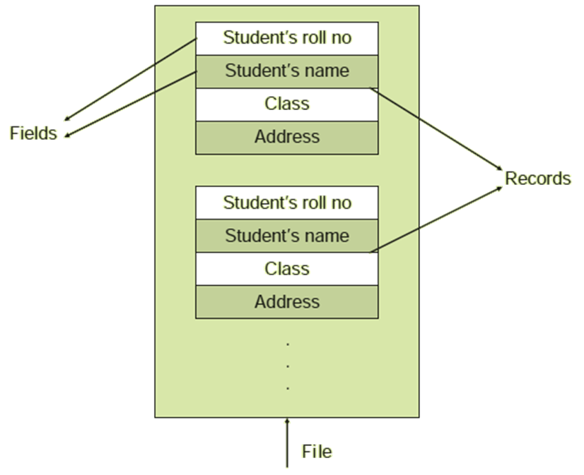
File structure

Slide 6
Internal structure and record blocking
A file may be considered as a sequence of blocks and therefore all basic I/O functions are performed in terms of blocks only. This is known as record blocking.

Slide 7



Blocking
Fixed blocking
Variable-length spanned blocking
Variable-length un-spanned blocking

Slide 8
File naming and file types
In general the file name has two parts separated by a period (.). The first part is the name of the file which the user wishes and the second part is known as an extension.
In general, there are following types of file:
Regular
Directory
Special

Slide 9
File attributes
General Information
Protection related attributes
Flags
Time of last change and last access

Slide 10
File operations
Create a File
Write a File
Saving a File
Deleting a File
Open a File
Close a File
Read a File
Append a File
Repositioning the current position pointer

Slide 11
Implementation of file operations
Data structures used for the opened files:
Open-file table
System-wide open file table
Address of the file on disk

Slide 12
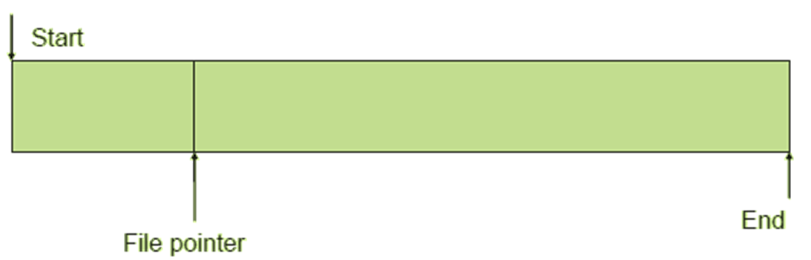
File access

Slide 13
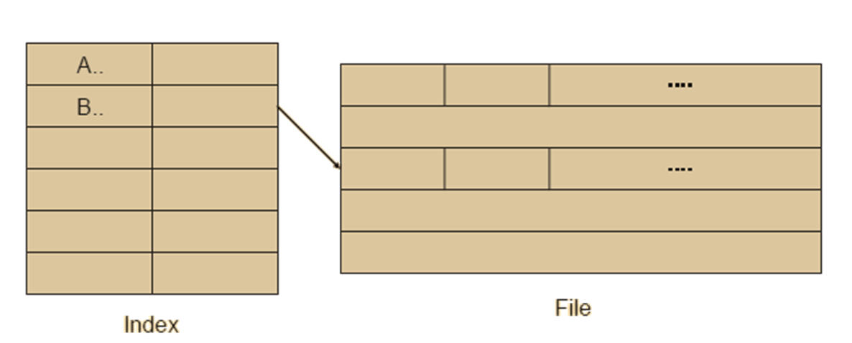
Indexed sequential file access

Slide 14
File access
Indexed file access
Direct file access

Slide 15
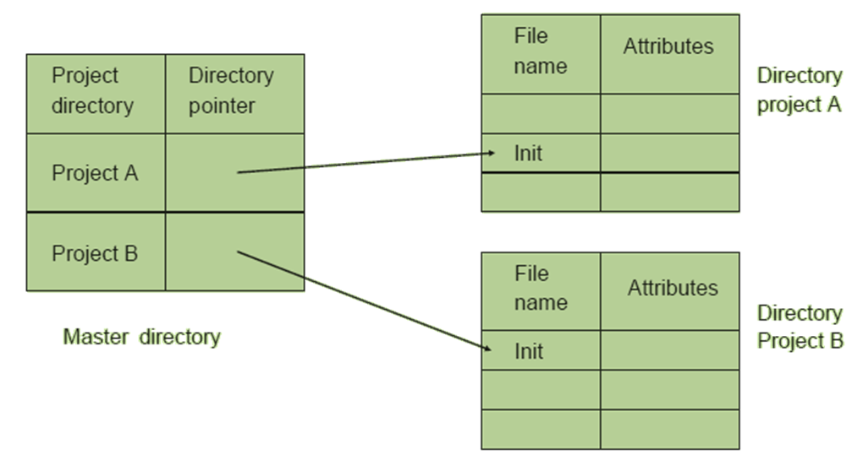
Directories
Naming freedom through master directory

Slide 16
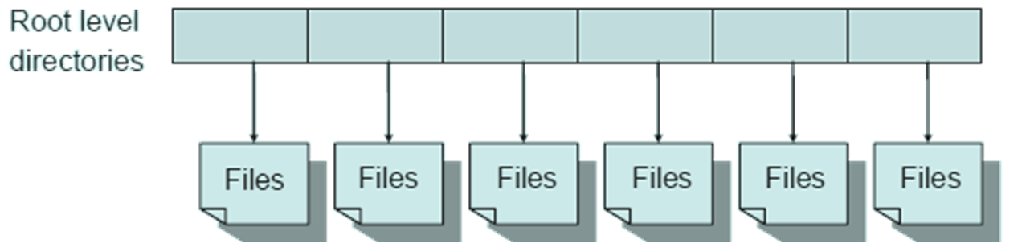
Single-level directory

Slide 17
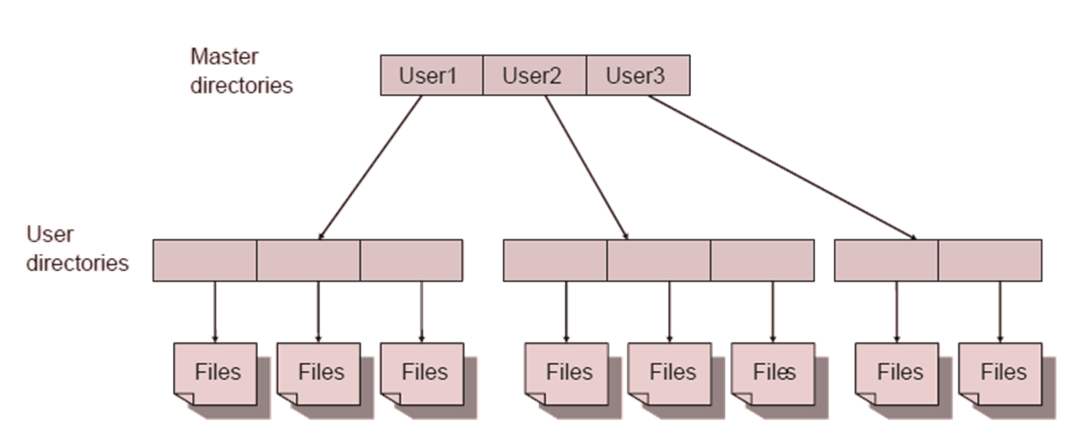
Two-level directory

Slide 18
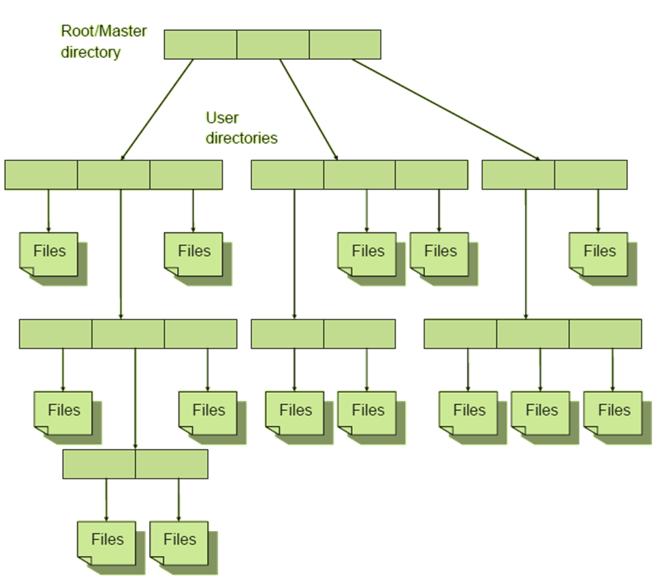
Hierarchical or Tree structure

Slide 19
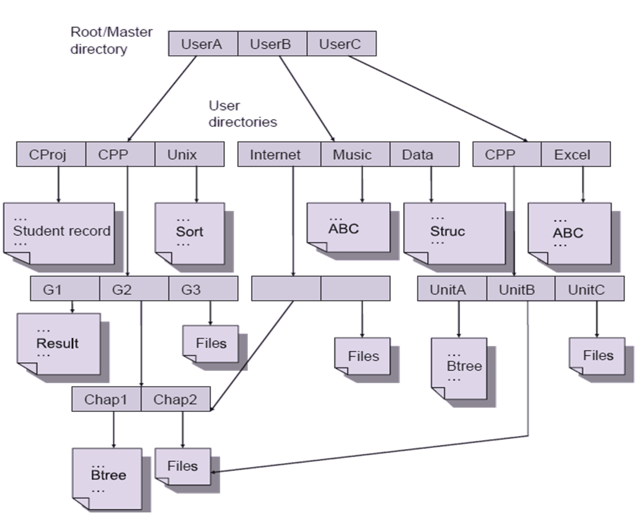
Acyclic graph structure and file sharing

Slide 20
File protection
Types of users
Individual user/owner: An individual user or the owner of a file who created the file.
User Group: A set of users who may share a file and require same type of access.
All: Any user
some access rights that may be exercised by any type of user discussed above:
Reading The user can read the file.
Writing The user can write, modify and delete any content of the file.
Appending The user is able to write at the end of file only.
Deleting The user can delete the file from the system.
Execution The user can load and execute a program but cannot copy it.
Listing The user is able to display the name and attributes of the file.

Slide 21
File system mounting
Every storage device/partition must be attached to root directory of the system before they can be used. This attaching of the device is known as mounting and directory where the device is attached is known as mount point.

